Slide 1

No Color Left Behind

Slide 2
Presented by
No Color Left Behind
Danielle Nay
Abby Hart
Whitney Johnson
Jon Rossi
CIS 1020-043
Fall 2012

Slide 3
For
President Bioteau
Salt Lake Community College

Slide 4
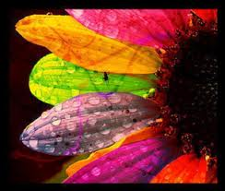
What is it?
No Color Left Behind is a company with the creative perspective that has the ability to bring color into people’s lives.

Slide 5

Benefits
Colors stimulate brain activity and emotions in varying ways
  Purple = logic and balance
  Yellow = alertness and decisiveness
  Brown = comfortable and at home
  Green = relaxation
  White = peacefulness
Dark colors lower stress and increase feelings of peacefulness.
Bright colors increase aggressive and nervous behavior.

Slide 6

Overall happiness is effected by the choice of color(s) surrounding students and staff.

Slide 7
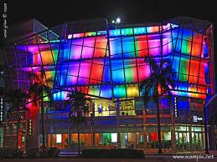
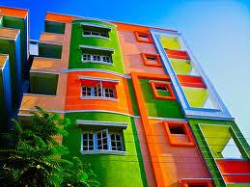
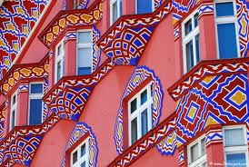
Addition of color brings in potential customers due to the dazzling detail.

Slide 8


Bonus Features
Random color effects also increase individual’s imagination and creativity
      Test the theory, try these!
      -coloring
      -site seeing

Slide 9
Overall Cost
$1,400
$5,250
$9,100
Costs vary depending on the square footage
of merchandise that is being renovated
-Prices start at $1,400 and travel up to $9,100

Slide 10
Holiday Discounts
No Color Left Behind also promotes seasonal rates to better serve customers. This creates better quality and understanding.

Slide 11
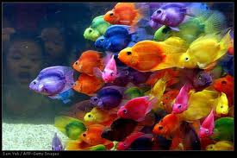

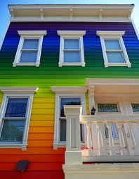
Please feel free to contact us by phone/e-mail or visit our office in person. Hope to see you soon!
123 Fake Street
Salt Lake City, UT 84123
Phone: 801-555-1234
Website: www.NCLB.com

